Slide 1
TITLE : BMI CaLCULATOR
Student Name : PARMAR RAJ S.
Enrollment ID : 24AIML029
Subject : Computer concepts & Programming
Objective : To calculate the BMI of a person using C programming
Course Learning Outcome : By the end of this project , students will be
able to apply basic arithmetic operations and health-related calculations in developing a BMI calculator using C.

Slide 2

PROGRAM OVERVIEW
The program calculates the Body Mass Index (BMI) for a given weight and height of a person. BMI is a simple and commonly used method to assess whether a person has a healthy weight for a given height. The program will prompt the user to input their weight (in kilograms) and height (in meters), then calculate and display the corresponding BMI value along with the BMI category.
BMI FORMULA
The formula to calculate BMI is : $\frac{W (kg)}{H∗H (m)}$ = BMI

Slide 3
BMI Categories:
Based on the calculated BMI, the program will categorize the result into the following ranges:
Underweight: BMI < 18.5
Normal weight: 18.5 ≤ BMI < 24.9
Overweight: 25 ≤ BMI < 29.9
Obesity: BMI ≥ 30
Key Features of the Program:
User Input: The program prompts the user to enter their weight (in kilograms) and height (in meters).
BMI Calculation: Using the formula, the program calculates the BMI.
BMI Classification: Based on the calculated BMI, the program displays the category (e.g., underweight, normal weight, etc.).
Validation: The program ensures that valid, non-negative input is provided by the user.
Output: The program outputs the BMI value and its classification.

Slide 4
CODE STRUCTURE
1. Include necessary libraries : We will use stdio.h for input/output.
2. Main Function :
Input weight and height.
Compute BMI using the formula.
Classify the result based on the BMI value.
Output the BMI value and the category.

Slide 5
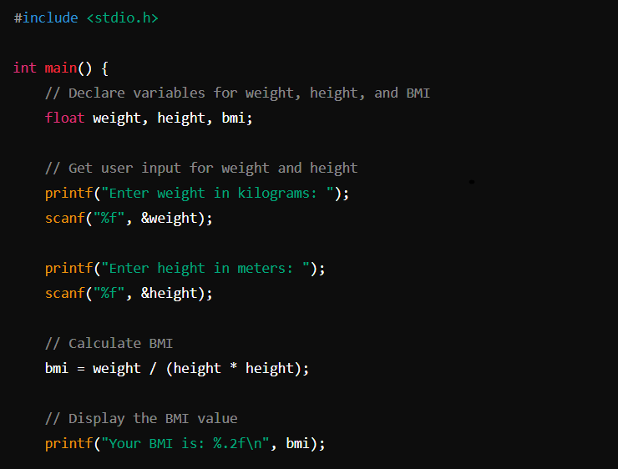
Code
Till here , the computer takes the height and weight from the user as input through scanf function.
By formula, the computer calculates the BMI according to the data given by the user and is displayed by printf function.

Slide 6
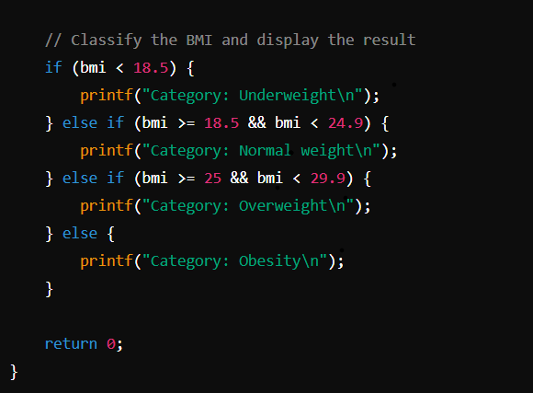
After getting BMI , we need to classify the BMI according to category where it belongs. We will use if - else statement to print the category.

Slide 7

OUTPUT

Slide 8
CONCLUSION
This C program is a simple but effective tool for calculating BMI and categorizing a person's weight status based on their height and weight. It demonstrates key concepts in C programming such as input/output handling, mathematical calculations, conditional statements, and basic program structure.

Slide 9


